Slide 1
Convolutional neural network
Hung-Hsuan Chen
Many slides are taken from Fei-Fei Li @Stanford

Slide 2
Convolutional Neural Network (CNN)
Widely used in computer vision
Image recognition
Given a photo, name the objects in the photo
Its variations are used in other fields
Natural language processing
Signal processing
AlphaGo

Slide 4
Naïve version: use fully connected feedforward neural network for object recognition
10-class classificaton

Slide 5
Possible problem
# of features is huge in single layer
A 256 * 256 image has 256 * 256 * 3 = 196,608 features
The number of parameters to learn may explode if we have more layers
Spatial features are not preserved
For object recognition, neighboring pixels are probably more important than the pixels that are farther away

Slide 6
Convolution kernel
Convolution kernel a.k.a. convolution a.k.a. kernel a.k.a. filter
The kernel slides through the entire image (mostly pixel by pixel)

Slide 7
Examples of human designed convolution kernels

Slide 8
Convolutional neural network
Design simple convolution kernels is probably possible
E.g., sharpen, smoothing (blur), etc.
Design complex convolution kernels is difficult
How to design a kernel to identify the motorcycles?
Convolutional neural network
Learning to find the convolution kernels to identify objects

Slide 9
Filters (almost) always extend the full depth of the input volume

Slide 11
This is called a “Convolution map” a.k.a. “feature map” a.k.a. “activation map”

Slide 16
Stride 2: jump 2 grids at a time

Slide 19
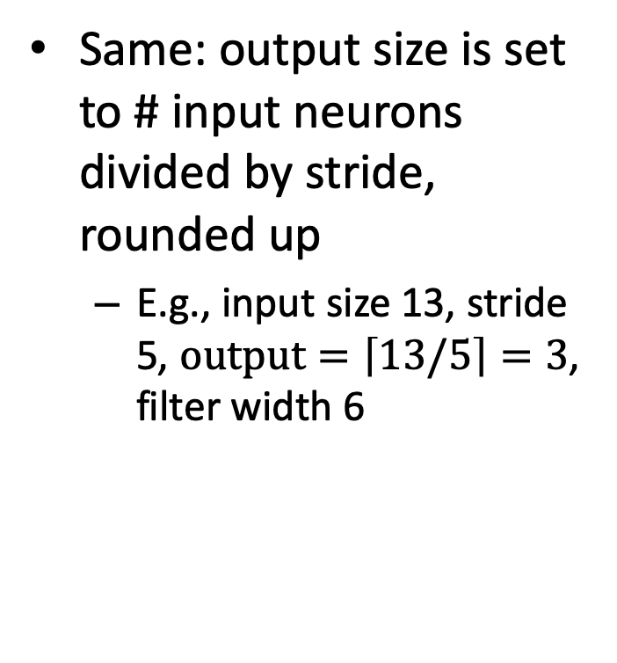
“Valid” vs “same” padding
Valid: convolution layer does not use zero padding, may ignore rows at the bottom or columns at right
Same: output size is set to # input neurons divided by stride, rounded up
E.g., input size 13, stride 5, $output=\left\lceil 13/5\right\rceil =3$, filter width 6
 |  |  |  |  |  |  |  |  |  |  | x | x
0 |  |  |  |  |  |  |  |  |  |  |  |  |  | 0 | 0
ignored
padding

Slide 20
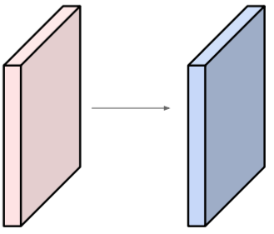
Quiz
Q: Input volume: 32x32x3; apply 10 5x5 filters with stride 1 and pad 2
What is the output volume size?
A: (1) for each filter, the output size is 32x32x1; (2) 10 such filters ➔ 32 x 32 x 10
How many parameters to learn in this layer?
A: (1) each filter contains 5x5x3+1 parameters (the +1 is the bias term); (2) 10 filters ➔ 76 x 10 = 760

Slide 21
Quiz
What is the relationship between a kernel and a feature map?

Slide 27
How to learn the parameters?
Compute the “local gradient” for each operator
Operators
Convolution
Pooling
Fully connected

Slide 28

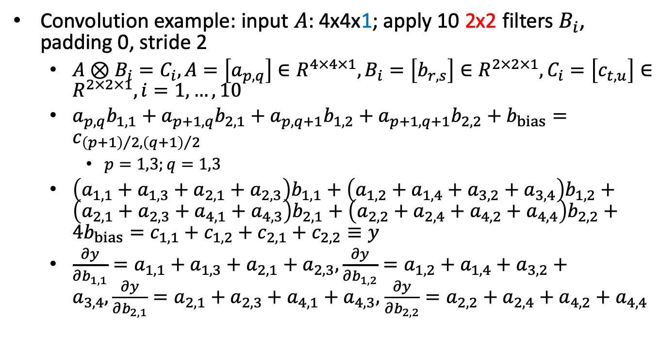
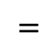
How to learn the parameters -- convolution
$$⨂$$
$$=$$
Convolution example: input $A$: 4x4x1; apply 10 2x2 filters $B_{i}$, padding 0, stride 2
$A⊗B_{i}=C_{i}, A=\left[a_{p,q}\right]∈R^{4×4×1},B_{i}=\left[b_{r,s}\right]∈R^{2×2×1},C_{i}=\left[c_{t,u}\right]∈R^{2×2×1}, i=1,…,10$
$a_{p,q}b_{1,1}+a_{p+1,q}b_{2,1}+a_{p,q+1}b_{1,2}+a_{p+1,q+1}b_{2,2}+b_{bias}=c_{{\left(p+1\right)}/2,{\left(q+1\right)}/2}$
$p=1,3;q=1,3$
$\left(a_{1,1}+a_{1,3}+a_{2,1}+a_{2,3}\right)b_{1,1}+\left(a_{1,2}+a_{1,4}+a_{3,2}+a_{3,4}\right)b_{1,2}+\left(a_{2,1}+a_{2,3}+a_{4,1}+a_{4,3}\right)b_{2,1}+\left(a_{2,2}+a_{2,4}+a_{4,2}+a_{4,4}\right)b_{2,2}+4b_{bias}=c_{1,1}+c_{1,2}+c_{2,1}+c_{2,2}≡y$
$\frac{∂y}{∂b_{1,1}}=a_{1,1}+a_{1,3}+a_{2,1}+a_{2,3},\frac{∂y}{∂b_{1,2}}=a_{1,2}+a_{1,4}+a_{3,2}+a_{3,4},\frac{∂y}{∂b_{2,1}}=a_{2,1}+a_{2,3}+a_{4,1}+a_{4,3},$ $\frac{∂y}{∂b_{2,2}}=a_{2,2}+a_{2,4}+a_{4,2}+a_{4,4}$

Slide 29
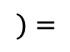
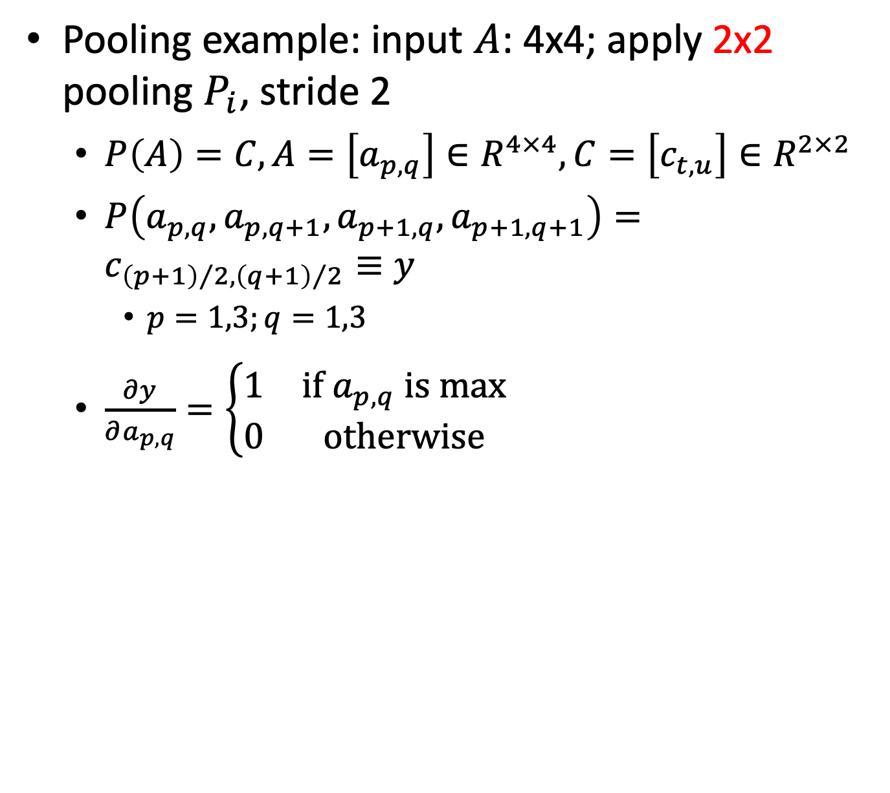
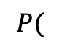
How to learn the parameters -- pooling
$$P($$
$$)=$$
Pooling example: input $A$: 4x4; apply 2x2 pooling $P_{i}$, stride 2
$P\left(A\right)=C, A=\left[a_{p,q}\right]∈R^{4×4}, C=\left[c_{t,u}\right]∈R^{2×2}$
$P\left(a_{p,q},a_{p,q+1},a_{p+1,q},a_{p+1,q+1}\right)=c_{{\left(p+1\right)}/2,{\left(q+1\right)}/2}≡y$
$p=1,3;q=1,3$
$\frac{∂y}{∂a_{p,q}}=\left\{\begin{matrix}1 & if a_{p,q} is max \\ 0 & otherwise\end{matrix}\right.$

Slide 30
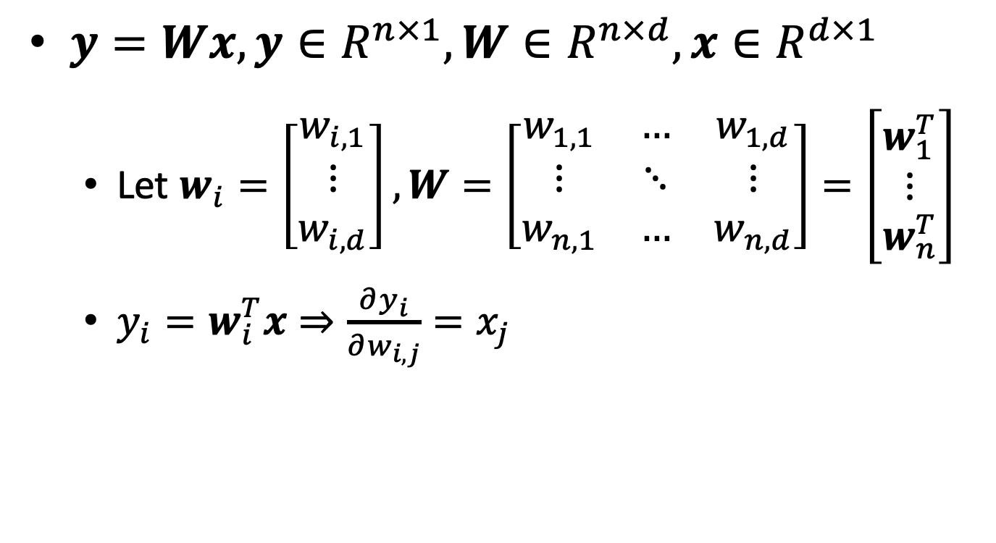
How to learn the parameters – fully connected
$y=Wx, y∈R^{n×1},W∈R^{n×d},x∈R^{d×1}$
Let $w_{i}=\left[\begin{matrix}w_{i,1} \\ ⋮ \\ w_{i,d}\end{matrix}\right], W=\left[\begin{matrix}w_{1,1} & … & w_{1,d} \\ ⋮ & ⋱ & ⋮ \\ w_{n,1} & … & w_{n,d}\end{matrix}\right]=\left[\begin{matrix}w_{1}^{T} \\ ⋮ \\ w_{n}^{T}\end{matrix}\right]$
$y_{i}=w_{i}^{T}x⇒\frac{∂y_{i}}{∂w_{i,j}}=x_{j}$

Slide 31
LeNet-5 – the “classic CNN”
LeCun, Yann, et al. "Gradient-based learning applied to document recognition." Proceedings of the IEEE 86.11 (1998): 2278-2324.

Slide 32
LeNet-5: C1 (convolution)
(32x32x1) ➔ (28x28x6)
Kernel size: 5x5
# kernels: 6
Activation function: sigmoid
# parameters: (5x5x1+1)x6 = 156
# connections: 156x28x28 = 122,304

Slide 33

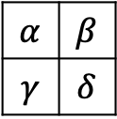
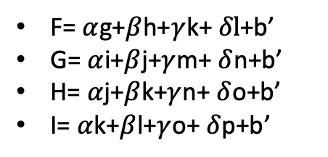
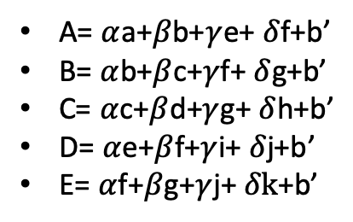
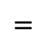
Why # parameters and # connections are different
Example: a 4x4 image with a 2x2 kernel
A 2x2 kernel has 2*2+1 (bias) = 5 parameters
The kernel is applied on 9 different regions of the 4x4 image, each location has 5 connections, so in total we have 9*5=45 connections
a | b | c | d
e | f | g | h
i | j | k | l
m | n | o | p
A= $α$a+$β$b+$γ$e+ $δ$f+b’
B= $α$b+$β$c+$γ$f+ $δ$g+b’
C= $α$c+$β$d+$γ$g+ $δ$h+b’
D= $α$e+$β$f+$γ$i+ $δ$j+b’
E= $α$f+$β$g+$γ$j+ $δk$+b’
F= $α$g+$β$h+$γ$k+ $δl$+b’
G= $α$i+$β$j+$γ$m+ $δ$n+b’
H= $α$j+$β$k+$γ$n+ $δ$o+b’
I= $α$k+$β$l+$γ$o+ $δ$p+b’
A | B | C
D | E | F
G | H | I
$$α$$ | $$β$$
$$γ$$ | $$δ$$
$$⊗$$
$$=$$
A
B
C
D
E
F
G
H
I
b’:
bias
a | b | c | d | e | f | g | h | i | j | k | l | m | n | o | p

Slide 34
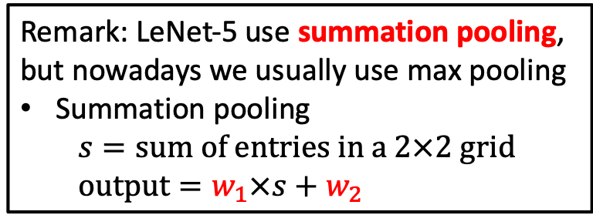
LeNet-5: S2 (subsampling)
(28x28x6) ➔ (14x14x6)
Kernel size: 2x2, stride=2
# kernels: 6
Activation function: sigmoid in the original paper, but often ignored nowadays
# parameters: (weighting, bias)x6 = 12
# connections: (2x2+1)x(14x14x6) = 5880
Remark: LeNet-5 use summation pooling, but nowadays we usually use max pooling
Summation pooling
$$s=sum of entries in a 2×2 grid$$
$$output=w_{1}×s+w_{2}$$

Slide 35
LeNet-5: C3
16 kernels
 | 1 | 2 | 3 | 4 | 5 | 6 | 7 | 8 | 9 | 10 | 11 | 12 | 13 | 14 | 15 | 16
1 | x |  |  |  | x | x | x |  |  | x | x | x | x |  | x | x
2 | x | x |  |  |  | x | x | x |  |  | x | x | x | x |  | x
3 | x | x | x |  |  |  | x | x | x |  |  | x |  | x | x | x
4 |  | x | x | x |  |  | x | x | x | x |  |  | x |  | x | x
5 |  |  | x | x | x |  |  | x | x | x | x |  | x | x |  | x
6 |  |  |  | x | x | x |  |  | x | x | x | x |  | x | x | x
6 input channels
(14x14x6) ➔ (10x10x16)
Kernel size: 5x5
# kernels: 16
Each kernel is only applied to different parts of input channels
Activation function: sigmoid
# parameters: (5x5x3+1)x6+(5x5x4+1)x6+(5x5x4+1)x3+(5x5x6+1)x1 = 1516
The colors map to the above table
# connections: 1516x10x10 = 151,600

Slide 36
LeNet-5: S4
LeNet-5 use summation pooling, but nowadays we usually use max pooling
(10x10x16) ➔ (5x5x16)
Kernel size: 2x2, stride=2
# kernels: 16
Activation function: sigmoid in the original paper, but often ignored nowadays
# parameters: (weighting, bias)x16 = 32
# connections: (2x2+1)x(5x5x16) = 2000

Slide 37
LeNet-5: C5
(5x5x16) ➔ (1x1x120)
Kernel size: 5x5
# kernels: 120
Activation function: sigmoid
# parameters: (5x5x16+1)x120=48120
# connections: 48120 (fully connected)

Slide 38
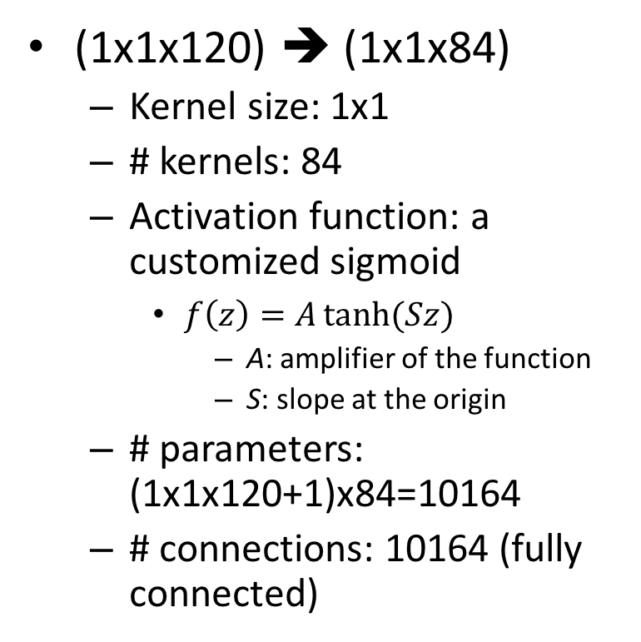
LeNet-5: F6 (fully connected)
(1x1x120) ➔ (1x1x84)
Kernel size: 1x1
# kernels: 84
Activation function: a customized sigmoid
$f\left(z\right)=A\tanh{(Sz)}$
A: amplifier of the function
S: slope at the origin
# parameters: (1x1x120+1)x84=10164
# connections: 10164 (fully connected)

Slide 39
LeNet-5: output layer
(1x1x84) ➔ (1x1x10)
Kernel size: 1x1
# kernels: 10
Activation function: none
# parameters: (1x1x84)x10=840
No bias term because RBF network is applied in the original paper (details ignored). Nowadays usually use softmax function

Slide 40
Summary of CNN
A special type of feedforward neural network
Conv layer
Connect to only a small subset of neurons in the neighboring layers
Subsampling (pooling) layer
Connect to only a small subset of neurons in the neighboring layers
Subsampling
Fully connected layer
Multi-class classification

Slide 41
ImageNet
# images: ~14M
# high level categories: 27
# sub-categories: ~21K
Collected from Amazon Mechanical Turk
http://image-net.org/about-stats

Slide 42
ILSVRC
ImageNet Large Scale Visual Recognition Competition
Annual competition (2010 – 2017)

Slide 43
Top-5 error rate
Top-5 error: check if the target label is one of the top 5 predictions

Slide 44
Case study: AlexNet
Won 2012 ImageNet ILSVRC challenge
Top-5 error rate: 16.4% (second place: 26%)
Important features
A deeper LeNet5
First use of ReLU
Heavy data augmentation
Dropout 0.5
SGD with momentum 0.9
Learning rate 0.01, reduce by 10 manually when val accuracy plateaus
Proposed Local Response Normalization Layers (LRN), but this is rarely used recently since usually not helpful

Slide 45
AlexNet architecture (1/2)

Slide 46
AlexNet architecture (2/2)
Layer | Type | # maps | Size | Kernel size | Stride | Padding | Activation
In | Input | 3 | 227X227 | - | - | - | -
C1 | Conv. | 96 | 55X55 | 11X11 | 4 | valid | ReLU
S2 | Max pool | 96 | 27X27 | 3X3 | 2 | valid | -
C3 | Conv. | 256 | 27X27 | 5X5 | 1 | same | ReLU
S4 | Max pool. | 256 | 13X13 | 3X3 | 2 | valid | -
C5 | Conv. | 384 | 13X13 | 3X3 | 1 | same | ReLU
C6 | Conv. | 384 | 13X13 | 3X3 | 1 | same | ReLU
C7 | Conv. | 256 | 13X13 | 3X3 | 1 | same | ReLU
F8 | Fully conn. | - | 4,096 | - | - | - | ReLU
F9 | Fully conn. | - | 4,096 | - | - | - | ReLU
out | Fully conn. | - | 1,000 | - | - | - | Softmax

Slide 47
ReLU vs tanh (reported in AlexNet paper)

Slide 48
Case study: ZFNet
Won 2013 IMageNet ILSVRC challenge
Top-5 error rate: 11.7%
A variant of AlexNet with improved hyper-parameters

Slide 49
ZFNet architecture
AlexNet, but
Conv1: change from (11X11) stride 4 to (7X7) stride 2
Conv3, 4, 5: increase # filters

Slide 50
Case study: GoogLeNet
Won 2014 ImageNet ILSVRC challenge
Top-5 error rate: 6.7%
Important features
Much deeper network (22 layers)
Invent inception module to reduce parameters
10 times fewer than AlexNet (6 million vs 60 million)
No fully connected layers

Slide 51
Inception module
(4) All outputs have the same height and width, making it possible to concatenate all results along the depth dimension
(3) Each pair of convolution layers ([1X1,3X3] and [1X1,5X5]) acts like a powerful convolution layer, capturing more complex patterns
(2) Different kernel size (1X1,3X3,5X5) to capture patterns at different scales
(1) Input is copied to 4 different layers

Slide 52
Full GoogLeNet
inceptions
Local Response Normalization (rarely used nowadays)
Auxiliary classifiers for training:
(1) combating gradient vanishing
(2) provide regularization

Slide 53
Parameters of each layer
Source: https://medium.com/coinmonks/paper-review-of-googlenet-inception-v1-winner-of-ilsvlc-2014-image-classification-c2b3565a64e7

Slide 54
Auxiliary classifier for training
Each auxiliary classifier is consists of
5x5 average pooling (stride 3)
1x1 conv (128 filters)
1024 FC
1000 FC
Softmax
Used in training, but not used in testing

Slide 55
Case study: VGGNet (Visual Geometry Group)
2nd in 2014 ImageNet ILSVRC challenge
Top-5 error rate: 7.3%
Important features
Small filters
Only 3X3 conv, stride 1, pad 1 and 3X3 max pool stride 2
deeper networks
16 – 19 layers

Slide 56
Case study: ResNet (Residual Network)
Won 2015 ImageNet ILSVRC challenge
Top-5 error rate: 3.57%
Important features
Extremely deep network (152 layers)
Skip connection (a.k.a., shortcut)

Slide 61


Why skip connection works?
For a regular network, initial weights are close to 0, so outputs are close to 0
If add skip connections, network outputs a copy of its input, may accelerate training
If add many skip connections, even if some layers have not started learning yet, the network can start making progress
$$+$$
$$+$$
Layer blocking backprop
Layer not learning
$$+$$
Layers that may still be learning

Slide 62
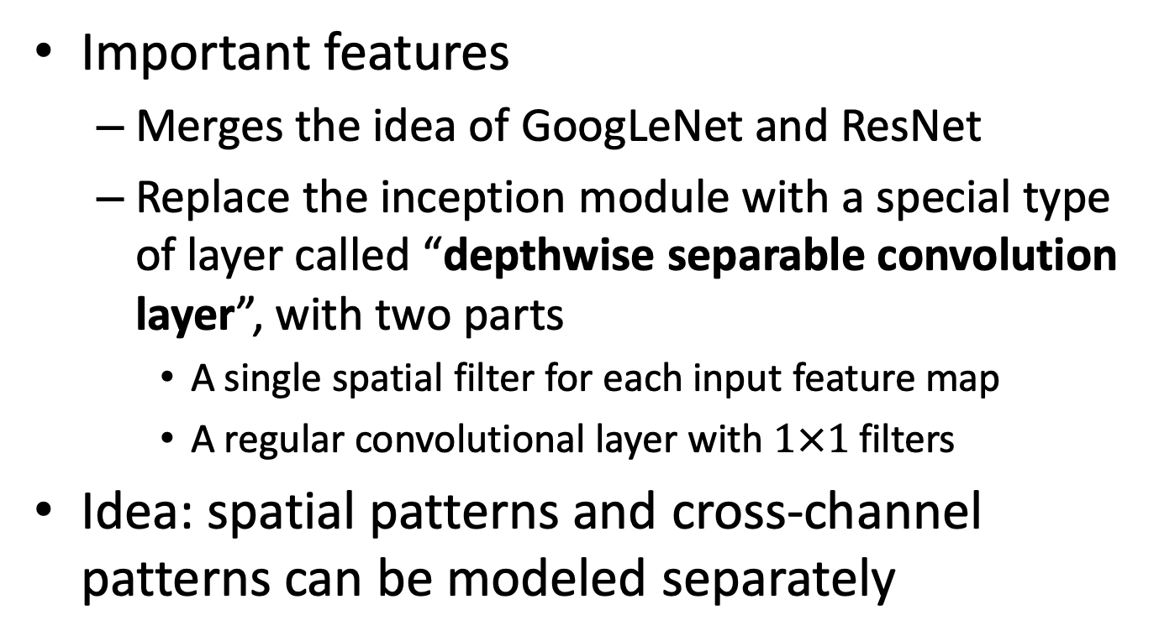
Case study: Xception
Important features
Merges the idea of GoogLeNet and ResNet
Replace the inception module with a special type of layer called “depthwise separable convolution layer”, with two parts
A single spatial filter for each input feature map
A regular convolutional layer with $1×1$ filters
Idea: spatial patterns and cross-channel patterns can be modeled separately

Slide 63
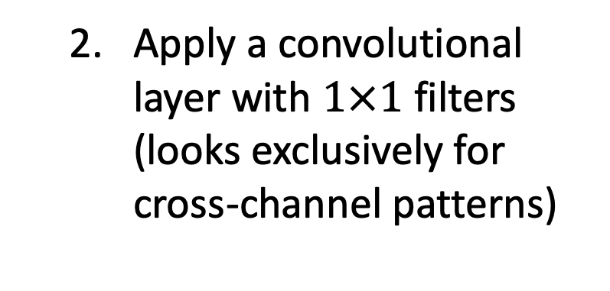
Depthwise separable convolution layer
Apply a single spatial filter for each input feature map (looks exclusively for spatial patterns)
Apply a convolutional layer with $1×1$ filters (looks exclusively for cross-channel patterns)

Slide 64
Case study: SENet (Squeeze-and Excitation Network)
Won 2017 ImageNet ILSVRC challenge
Top-5 error rate: 2.25%
Important features
Extends existing architectures such as inception and ResNet
SE-Inception and SE-ResNet
Adds a SE block (a small NN) to every unit in the original architecture

Slide 65

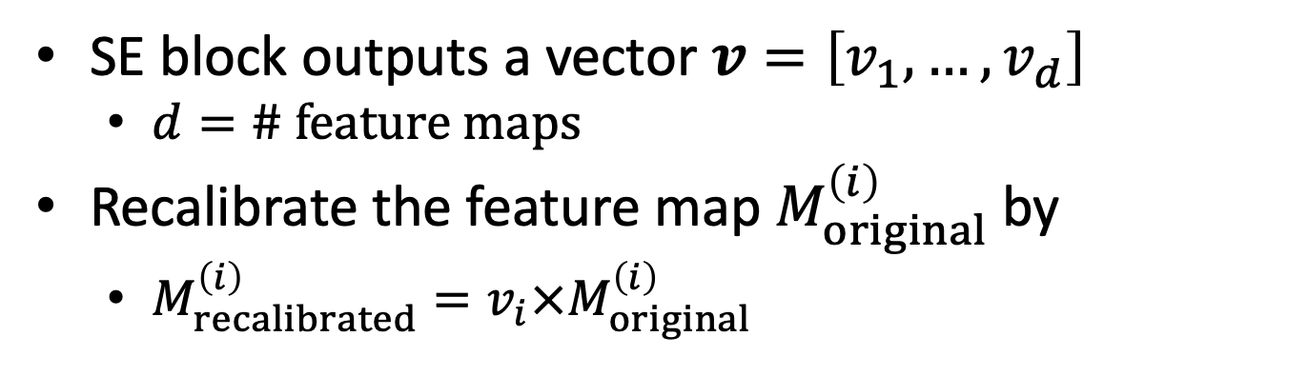
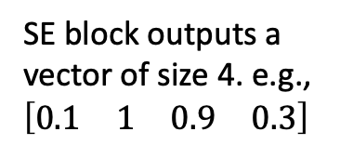
Integrate SE block into existing network architecture
# feature maps: 4
SE block outputs a vector of size 4. e.g., $\left[\begin{matrix}\begin{matrix}0.1 & 1\end{matrix} & \begin{matrix}0.9 & 0.3\end{matrix}\end{matrix}\right]$
SE block
$$×$$
Original feature maps
Elementwise product
Recalibrated feature maps
SE block outputs a vector $v=\left[v_{1},…,v_{d}\right]$
$d=\# feature maps$
Recalibrate the feature map $M_{original}^{\left(i\right)}$by
$M_{recalibrated}^{\left(i\right)}=v_{i}×M_{original}^{\left(i\right)}$

Slide 66
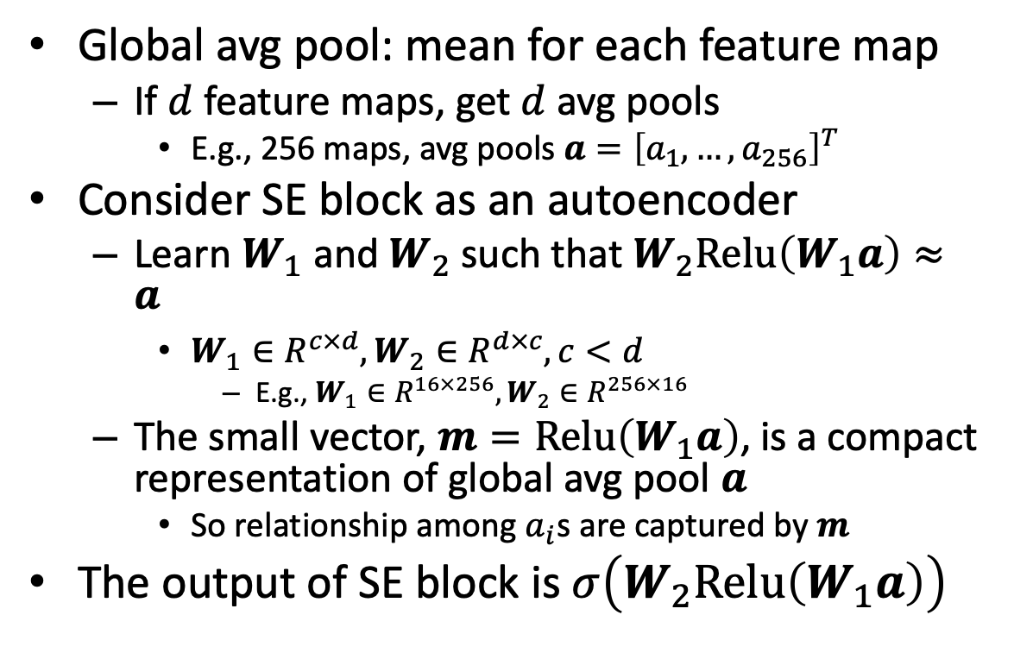
SE block architecture
Global avg pool: mean for each feature map
If $d$ feature maps, get $d$ avg pools
E.g., 256 maps, avg pools $a={\left[a_{1},…,a_{256}\right]}^{T}$
Consider SE block as an autoencoder
Learn $W_{1}$ and $W_{2}$ such that $W_{2}Relu\left(W_{1}a\right)≈a$
$W_{1}∈R^{c×d},W_{2}∈R^{d×c}, c<d$
E.g., $W_{1}∈R^{16×256},W_{2}∈R^{256×16}$
The small vector, $m=Relu\left(W_{1}a\right)$, is a compact representation of global avg pool $a$
So relationship among $a_{i}$s are captured by $m$
The output of SE block is $σ\left(W_{2}Relu\left(W_{1}a\right)\right)$
Dense
Dense
Global avg pool

Slide 67
Why SE works?
Assume 3 feature maps capture the patterns of “eyes”, “noses”, and “mouths”
An SE block may learn they usually appear together in pictures
If SE sees strong signal for eyes and nose feature maps, SE may boost the strength of the mouth map

Slide 68
AlphaGo

Slide 69
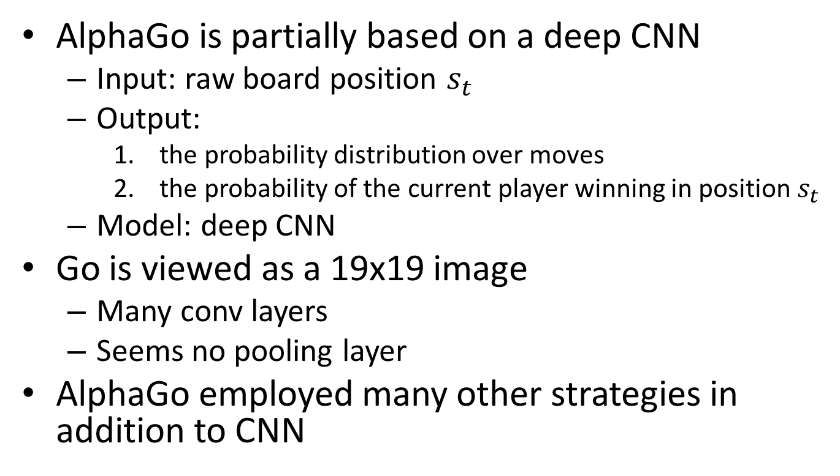
AlphaGo and CNN
AlphaGo is partially based on a deep CNN
Input: raw board position $s_{t}$
Output:
the probability distribution over moves
the probability of the current player winning in position $s_{t}$
Model: deep CNN
Go is viewed as a 19x19 image
Many conv layers
Seems no pooling layer
AlphaGo employed many other strategies in addition to CNN

Slide 70
CNN on sound wave
Sound wave in time domain can be transformed into “spectrogram”

Slide 71
CNN on sound wave
Apply variants of (Deep-)CNN on the spectrogram

Slide 72
CNN on traffic flow prediction
Traffic flow on the highway can be considered as a “1D” image
# cars within a area is considered as “pixel” values
Apply variants of (Deep-)CNN

Slide 73
Critics on CNN (by G. Hinton)
The orientational information is missing
The relative spatial relationship between components is missing
Why? ➔ Higher-level features are the weighted sum of the lower-level features
Hinton proposed Capsule Network (CapsNet) to address some of these issues (in Nov. 2017)
Sabour, Sara, Nicholas Frosst, and Geoffrey E. Hinton. "Dynamic routing between capsules." Advances in Neural Information Processing Systems. 2017.

Slide 74
Conclusion
(Deep-)CNN is a special type of feedforward neural network
Variations of (Deep-)CNN perform extremely well on various computer vision tasks
Trend: deeper, but fewer parameters
Training extra-deep network is difficult
Mainly due to optimization strategy
Faster and more stable training
Improving gradient flow
Improving network structure

